Slide 1
Success for All Learners within the New Zealand Education System
For the 2017 Community Core Leaders Development Program Delegation to New Zealand 10 October 2017
Learning Support: Ministry of Education New Zealand
Matauranga House
Wellington, New Zealand

Slide 2
Agenda:
Introductions and Welcomes
The New Zealand Education Context
System Policies and Strategies
Learning Support Services and Support

Slide 3
Whakatauki
Mā te huruhuru te manu karere
With feathers a bird flies

Slide 4
Education Act 1989

Slide 5
Education Regions in NZ
North Island:
Tai Tokerau
Auckland
Waikato
Bay of Plenty, Waiariki
Hawkes Bay, Tairāwhiti
Taranaki, Whanganui, Manawatu
Wellington
South Island:
Wellington
Nelson, Malborough, West coast
Canterbury
Otago, Southland
Schools: 1,886
ECE Centres: 3,585
Schools: 649
ECE Centres: 904

Slide 6
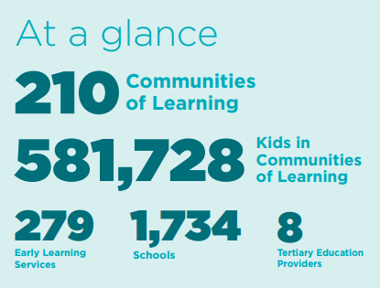
Communities of Learning | Kāhui Ako
Groups of education and training providers that form around children and young people's learning pathways, and work together to help them achieve their full potential.

Slide 7
Our Curricula

Slide 8
What do our children say?
https://www.youtube.com/watch?v=dFtIfh7pV4k

Slide 9
NZ Disability Strategy
Disabled children are growing up wanting the same things as non-disabled children.
Expectations of disabled adults have changed.
Disabled people are experts in their own lives.
They have a right to be involved in the decisions that impact on them and will lead to better outcomes.
https://www.odi.govt.nz/nz-disability-strategy/

Slide 10
Success for All: Building an inclusive education system
Value everyone
Respect diversity
Equity for all

Slide 11
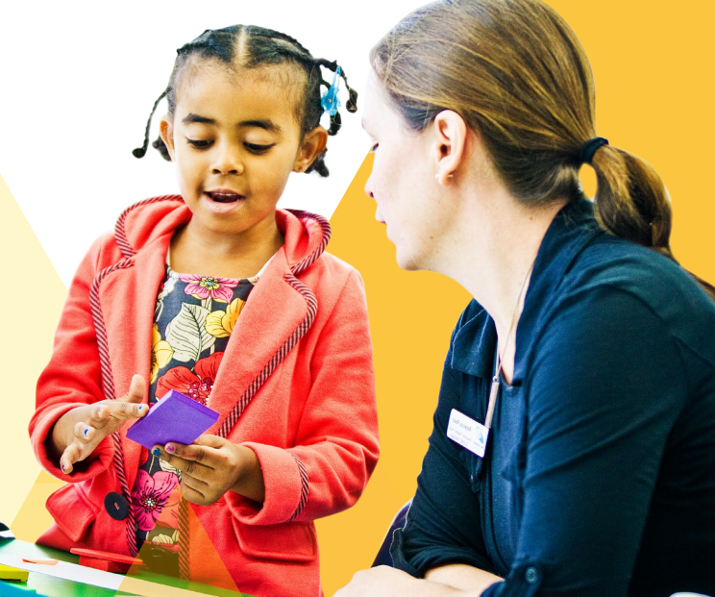
Learning Support Update

Slide 12
Learning Support Model
Collaborative practice:
schools and early learning providers working together to better support children and young people.
Better Facilitation:
a facilitator within each Kāhui Ako to provide a point of contact and coordination for learning support
More Flexibility:
enabling specialists and decision makers to use their judgment about the supports required for a child or young person
A single point of contact:
a key worker to be the primary point of contact for each child or young person receiving individualised learning supports
A move to one plan
having one plan for each child or young person receiving individualised learning support services.

Slide 13
Resourcing Framework
School
High Health
Needs Funding**
Ongoing Resourcing Scheme
Residential Special Schools & Intensive Wraparound Service
High special education needs
(3% of school-aged children)
Speech Language Initiative
Severe Behaviour Initiative
Resource Teachers: Learning and Behaviour
Moderate to high special education needs (4-6% of school-aged children)
Physical, Hearing, Vision & Health Services*
Special Education Grant
Early childhood resourcing
(5% of children 0-5 years)
Early Intervention Services
Te Aho o te Kura Pounamu (Te Kura)
School Transport Assistance
Assistive
Technology
Property
Modifications
SUCCESS FOR ALL: EVERY SCHOOL, EVERY CHILD
POSITIVE BEHAVIOUR FOR LEARNING
*Includes schools for students with vision and hearing, behavioural, or cognitive impairments.
**School High Health Needs funding provides teacher’s aides support for students with high health needs.

Slide 14
Inclusive Education
Inclusive education is where all children and young people are engaged and achieve through being present, participating, learning and belonging.
Inclusive schools:
have ethical standards and leadership that build the culture of an inclusive school
have well-organised systems, effective teamwork and constructive relationships that identify and support the inclusion of all students
use innovative and flexible practices that respond to the needs of all students.
http://inclusive.tki.org.nz/

Slide 15
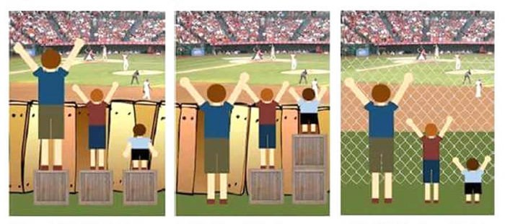
Inclusive Education
Inclusive education is where all children and young people are engaged and achieve through being present, participating, learning and belonging.
Universal Design for Learning (UDL)
-research-based
-design more flexible learning environments
-everyone is learning and achieving
-diversity is a strength
https://vimeo.com/album/2950799/video/220717678

Slide 16
Positive Behaviour for Learning
Encourage positive behaviour
Strengthen relationships
Increase student wellbeing
Creating caring and inclusive learning environments

Slide 17
Resource Teachers: Learning and Behaviour
Resource Teachers: Learning and Behaviour (RTLB):
are fully-registered specialist teachers
have the specialist training and skills
work with teachers and schools to identify and respond to barriers to learning
build teacher and school inclusive practice capability

Slide 18
Learning Support Services
Communication:
Speech Language Therapists
5 to 8 years of age
Difficulty with talking and communicating
Behaviour:
Educational Psychologists
5 to 14 years of age
Affects relationships, learning and safety
Early Intervention:
Advisors on Deaf Children, Early Intervention Teachers, Psychologists, Speech Language Therapists
Birth to 5 years old
Concerns with development, disability, behaviour and/or communication
Physical disability:
Occupational Therapists and Physiotherapists
Challenges fine motor skills and mobility to fully participate in learning programmes and everyday tasks

Slide 19
Ongoing Resourcing Scheme (ORS)
ORS:
Provides support to schools for students with the very highest need for learning support
1% of the total schooling population
High or very high needs in any of the areas of learning, hearing, vision, physical, language use and social communication
Services and support include:
specialists such as speech-language therapists, psychologists, occupational therapists, physiotherapists, advisers on deaf children, special education advisors
additional or specialist teachers who work directly with students and prepare resources for them
teacher aides to support teachers to include students in class programmes and activities
Transition guidelines for supporting young people out of school https://education.govt.nz/school/student-support/special-education/national-transition-guidelines-for-students-with-special-education-needs/

Slide 20
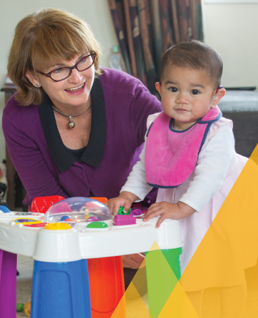
Specialists Roles
Speech Language Therapists
Occupational Therapists
Physiotherapists
Special Education Advisors
Early Intervention Teachers
Educational Psychologists
Kaitakawaenga
Education Support Workers
Advisors of Deaf Children
Resource Teachers Vision
Resource Teachers Deaf

Slide 21
Equity is when every child and young person has what they need to succeed.

