Slide 1
New Zealand Disability Strategy 2016-2026
Prepared for the Japanese Young Core Leaders Programme
Jacinda Keith

Slide 2
How it all fits together
The UN Convention on the Rights of Persons with Disabilities
The New Zealand Disability Strategy
The Outcomes Framework
The Disability Action Plan
The work of agencies not in the Disability Action Plan
The work of other Non-government organisations

Slide 3
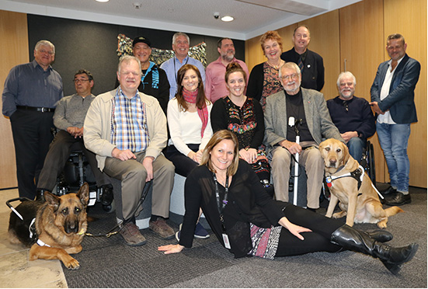
We appointed a reference group to provide expert advice

Slide 4

We developed a purpose built website for the revision

Slide 5
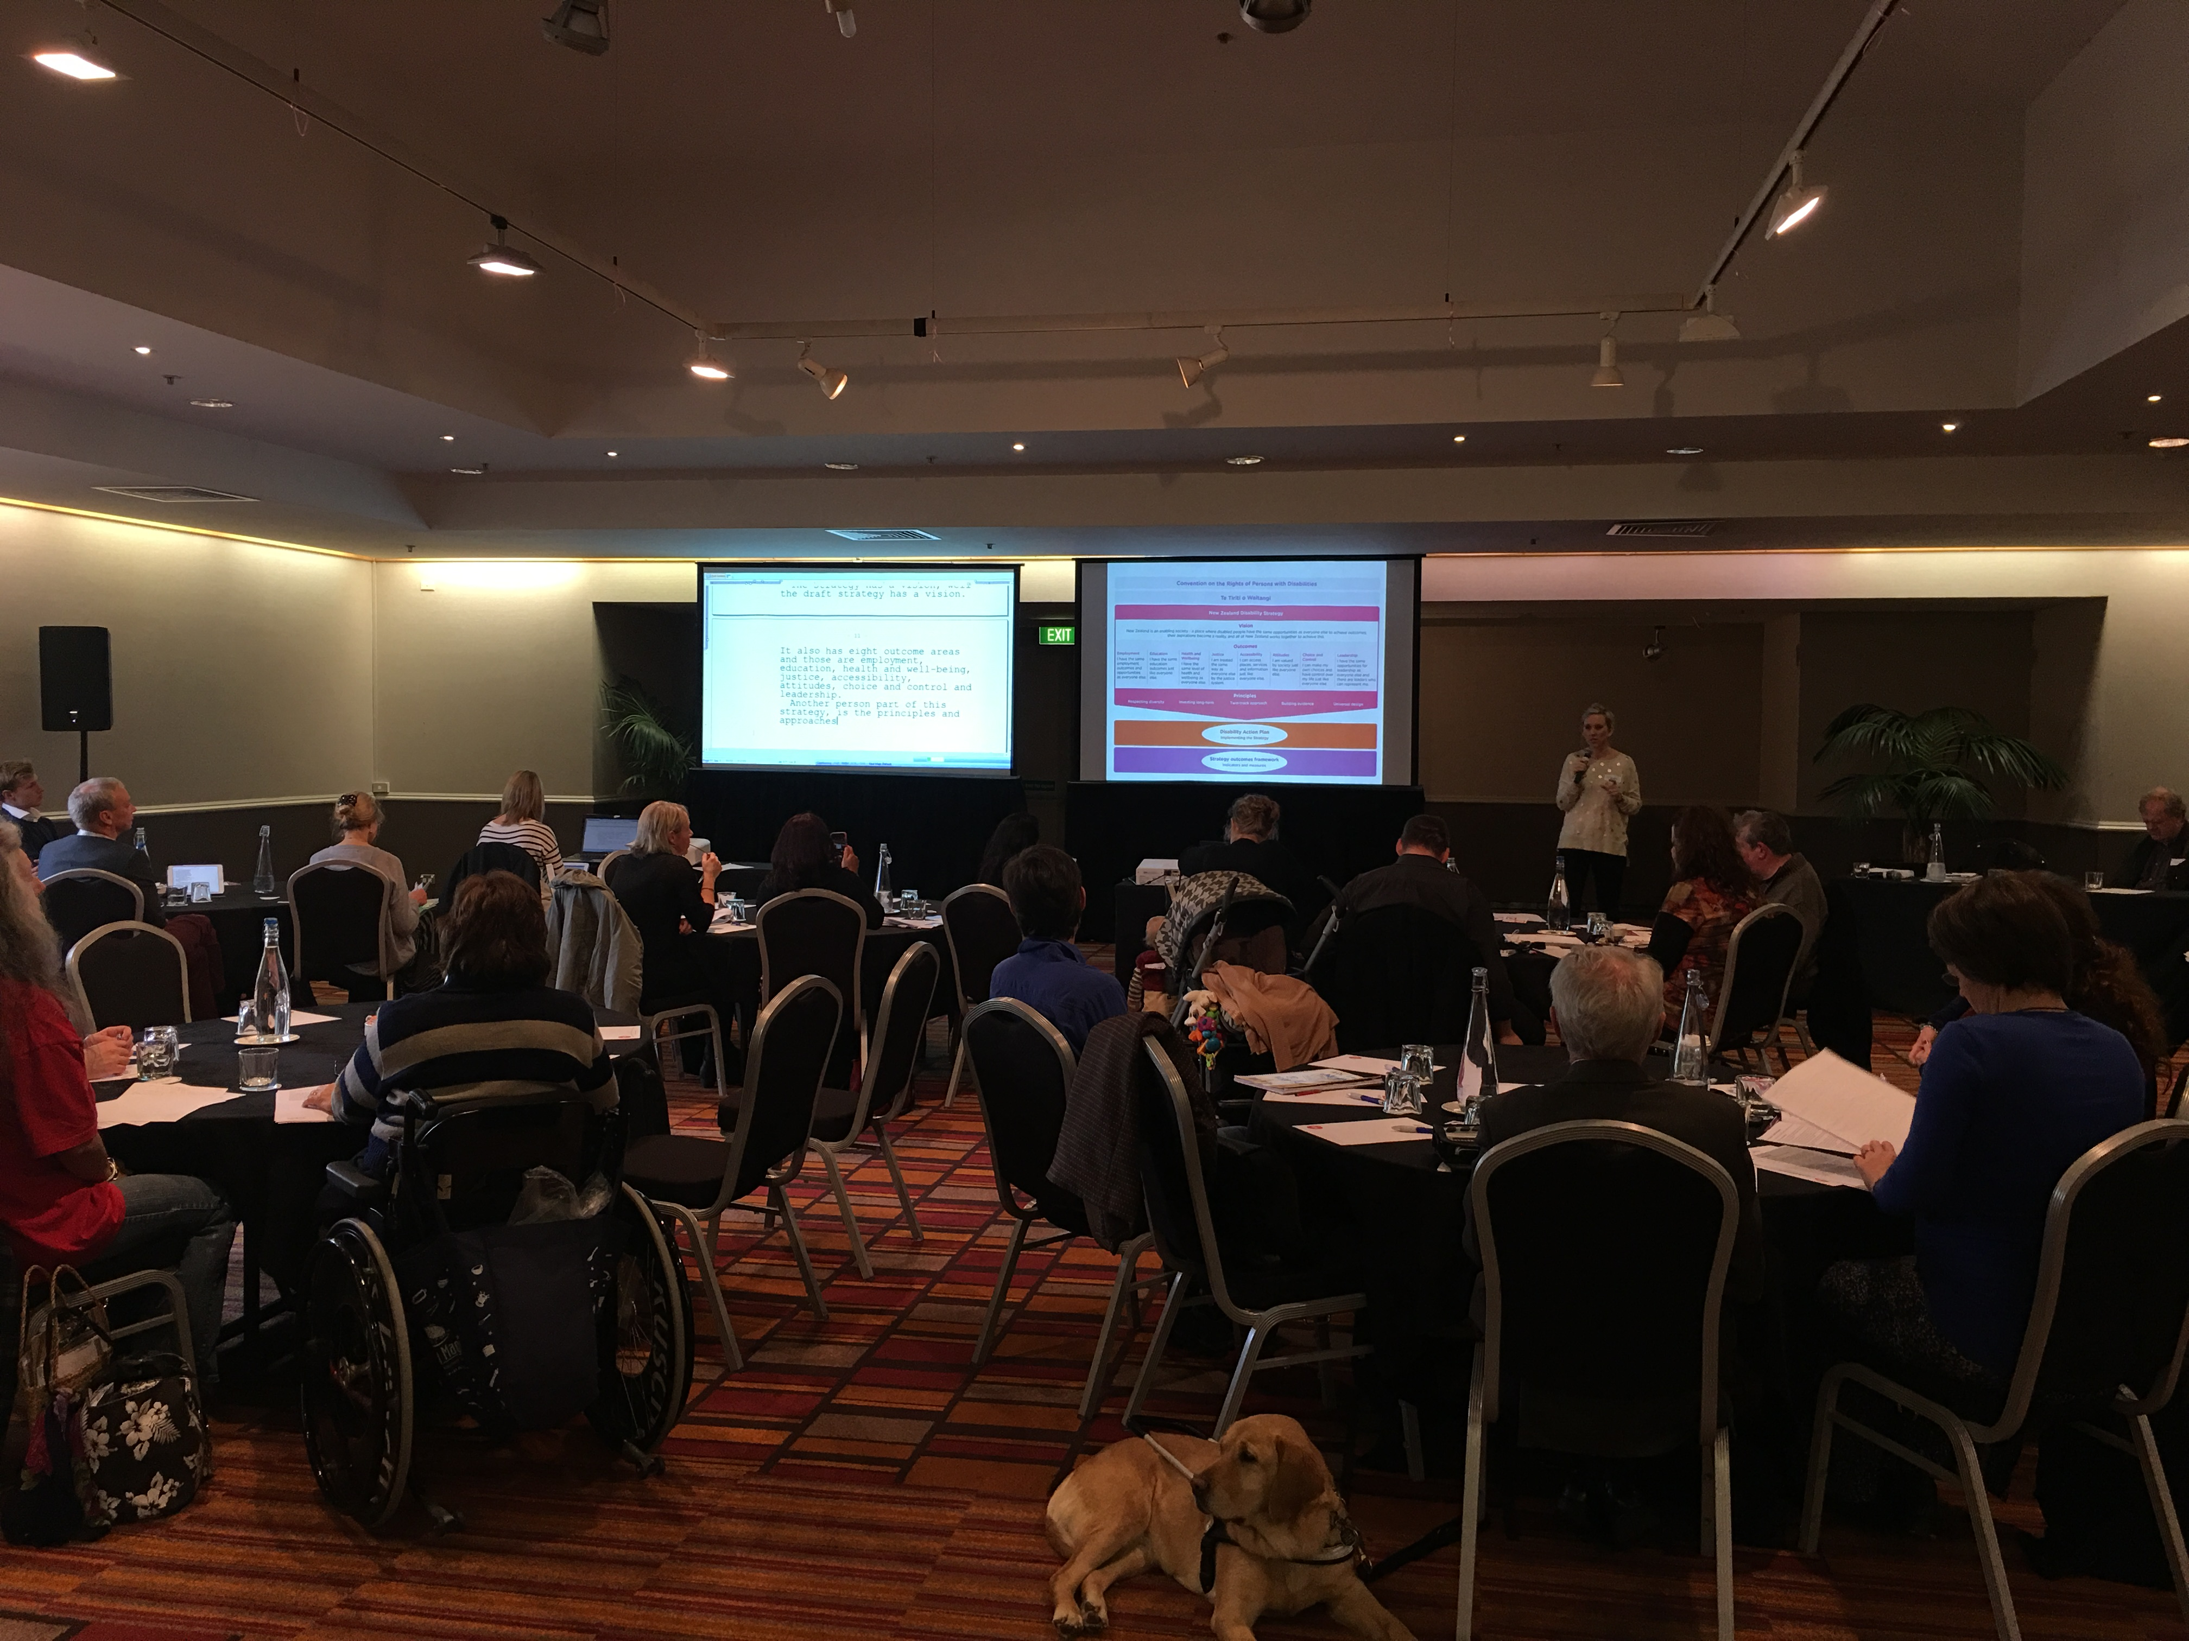
Two rounds of public consultation –accessible to all

Slide 6
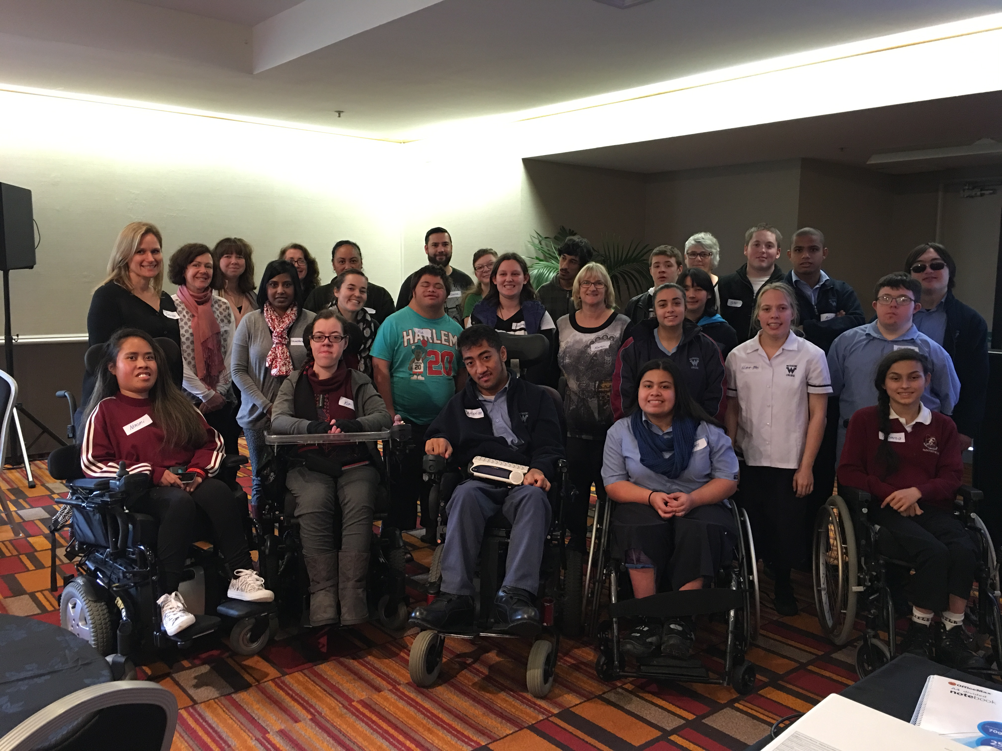
We held discussions with groups – disabled youth

Slide 7
A new Strategy to guide us for 10 years
Vision
New Zealand is a non-disabling society
- a place where disabled people have an equal opportunity to achieve their goals and aspirations, and all of New Zealand works together to make this happen.

Slide 8
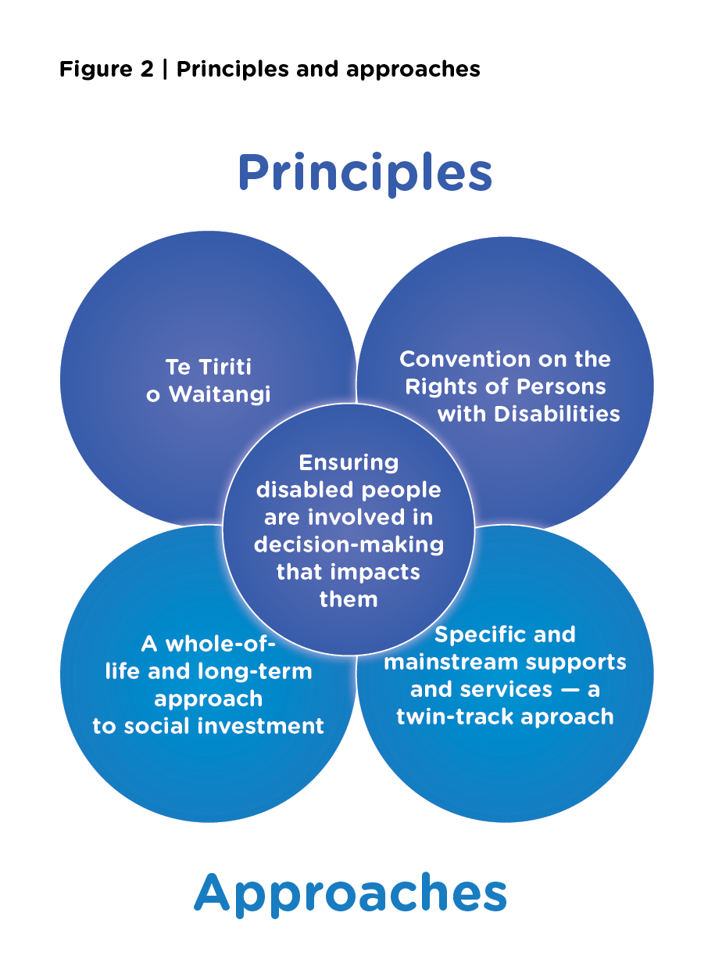
Five Principles and Approaches

Slide 9
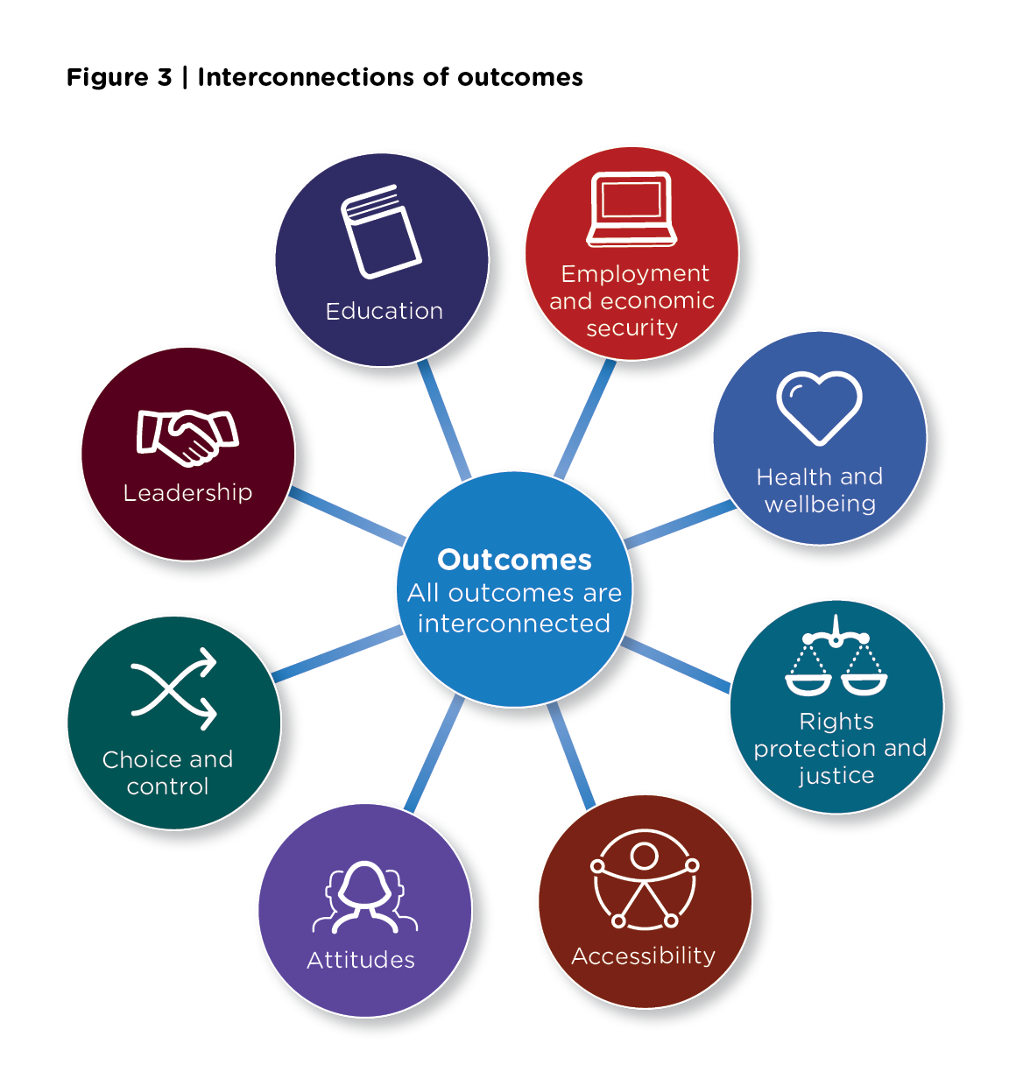
New Strategy has eight outcome domains
Priorities for change
Education
Employment and economic
security
Health & wellbeing
Rights protection & justice
Accessibility
Attitudes
Choice & control
Leadership

Slide 10
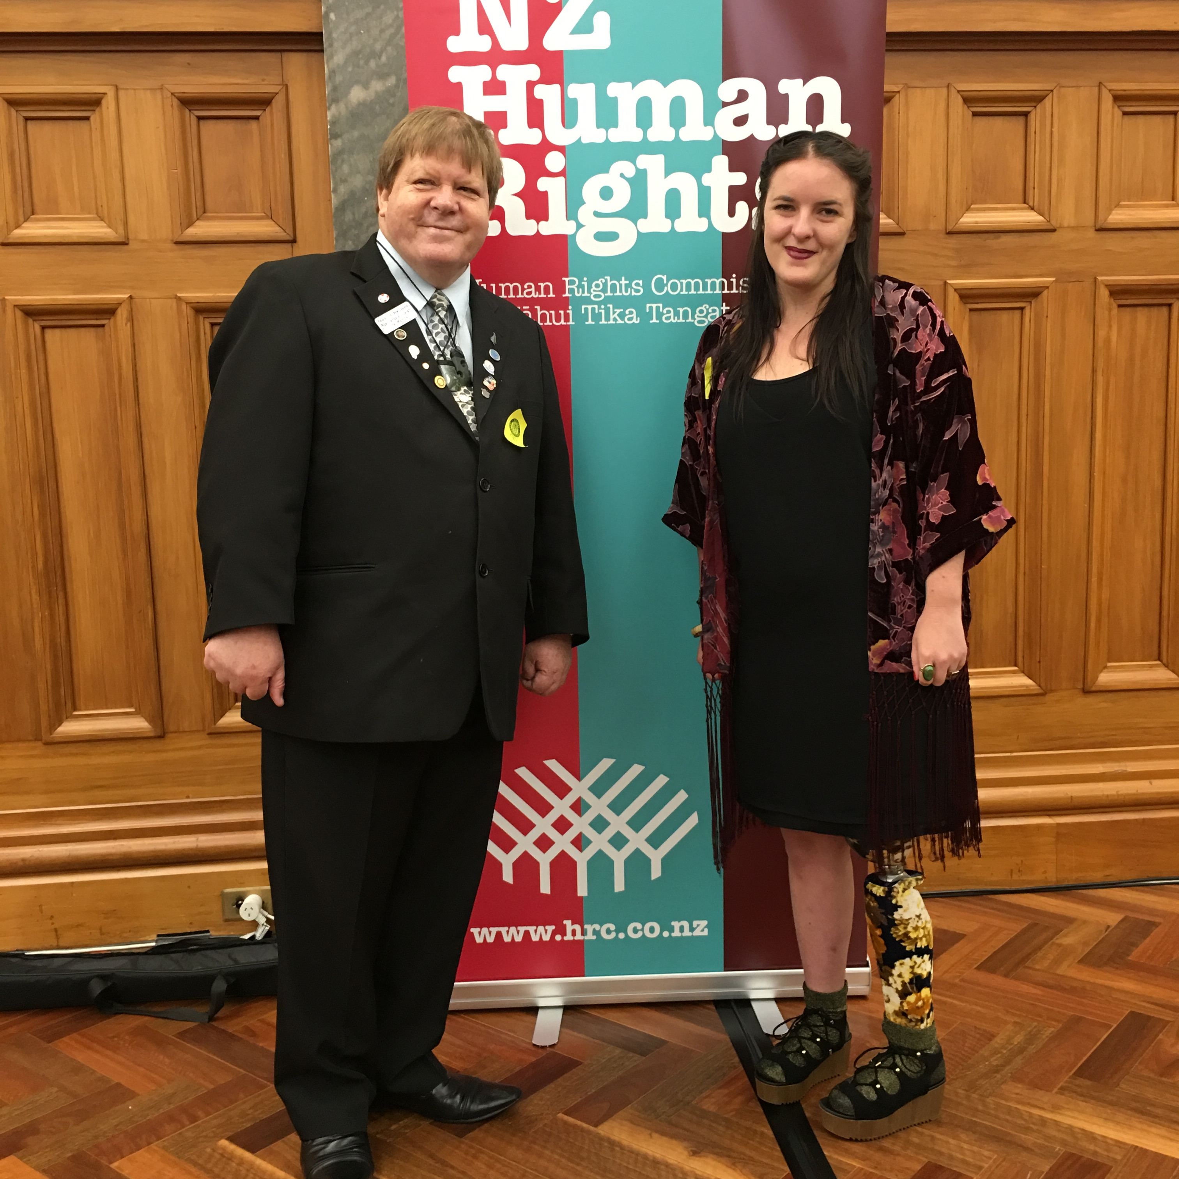
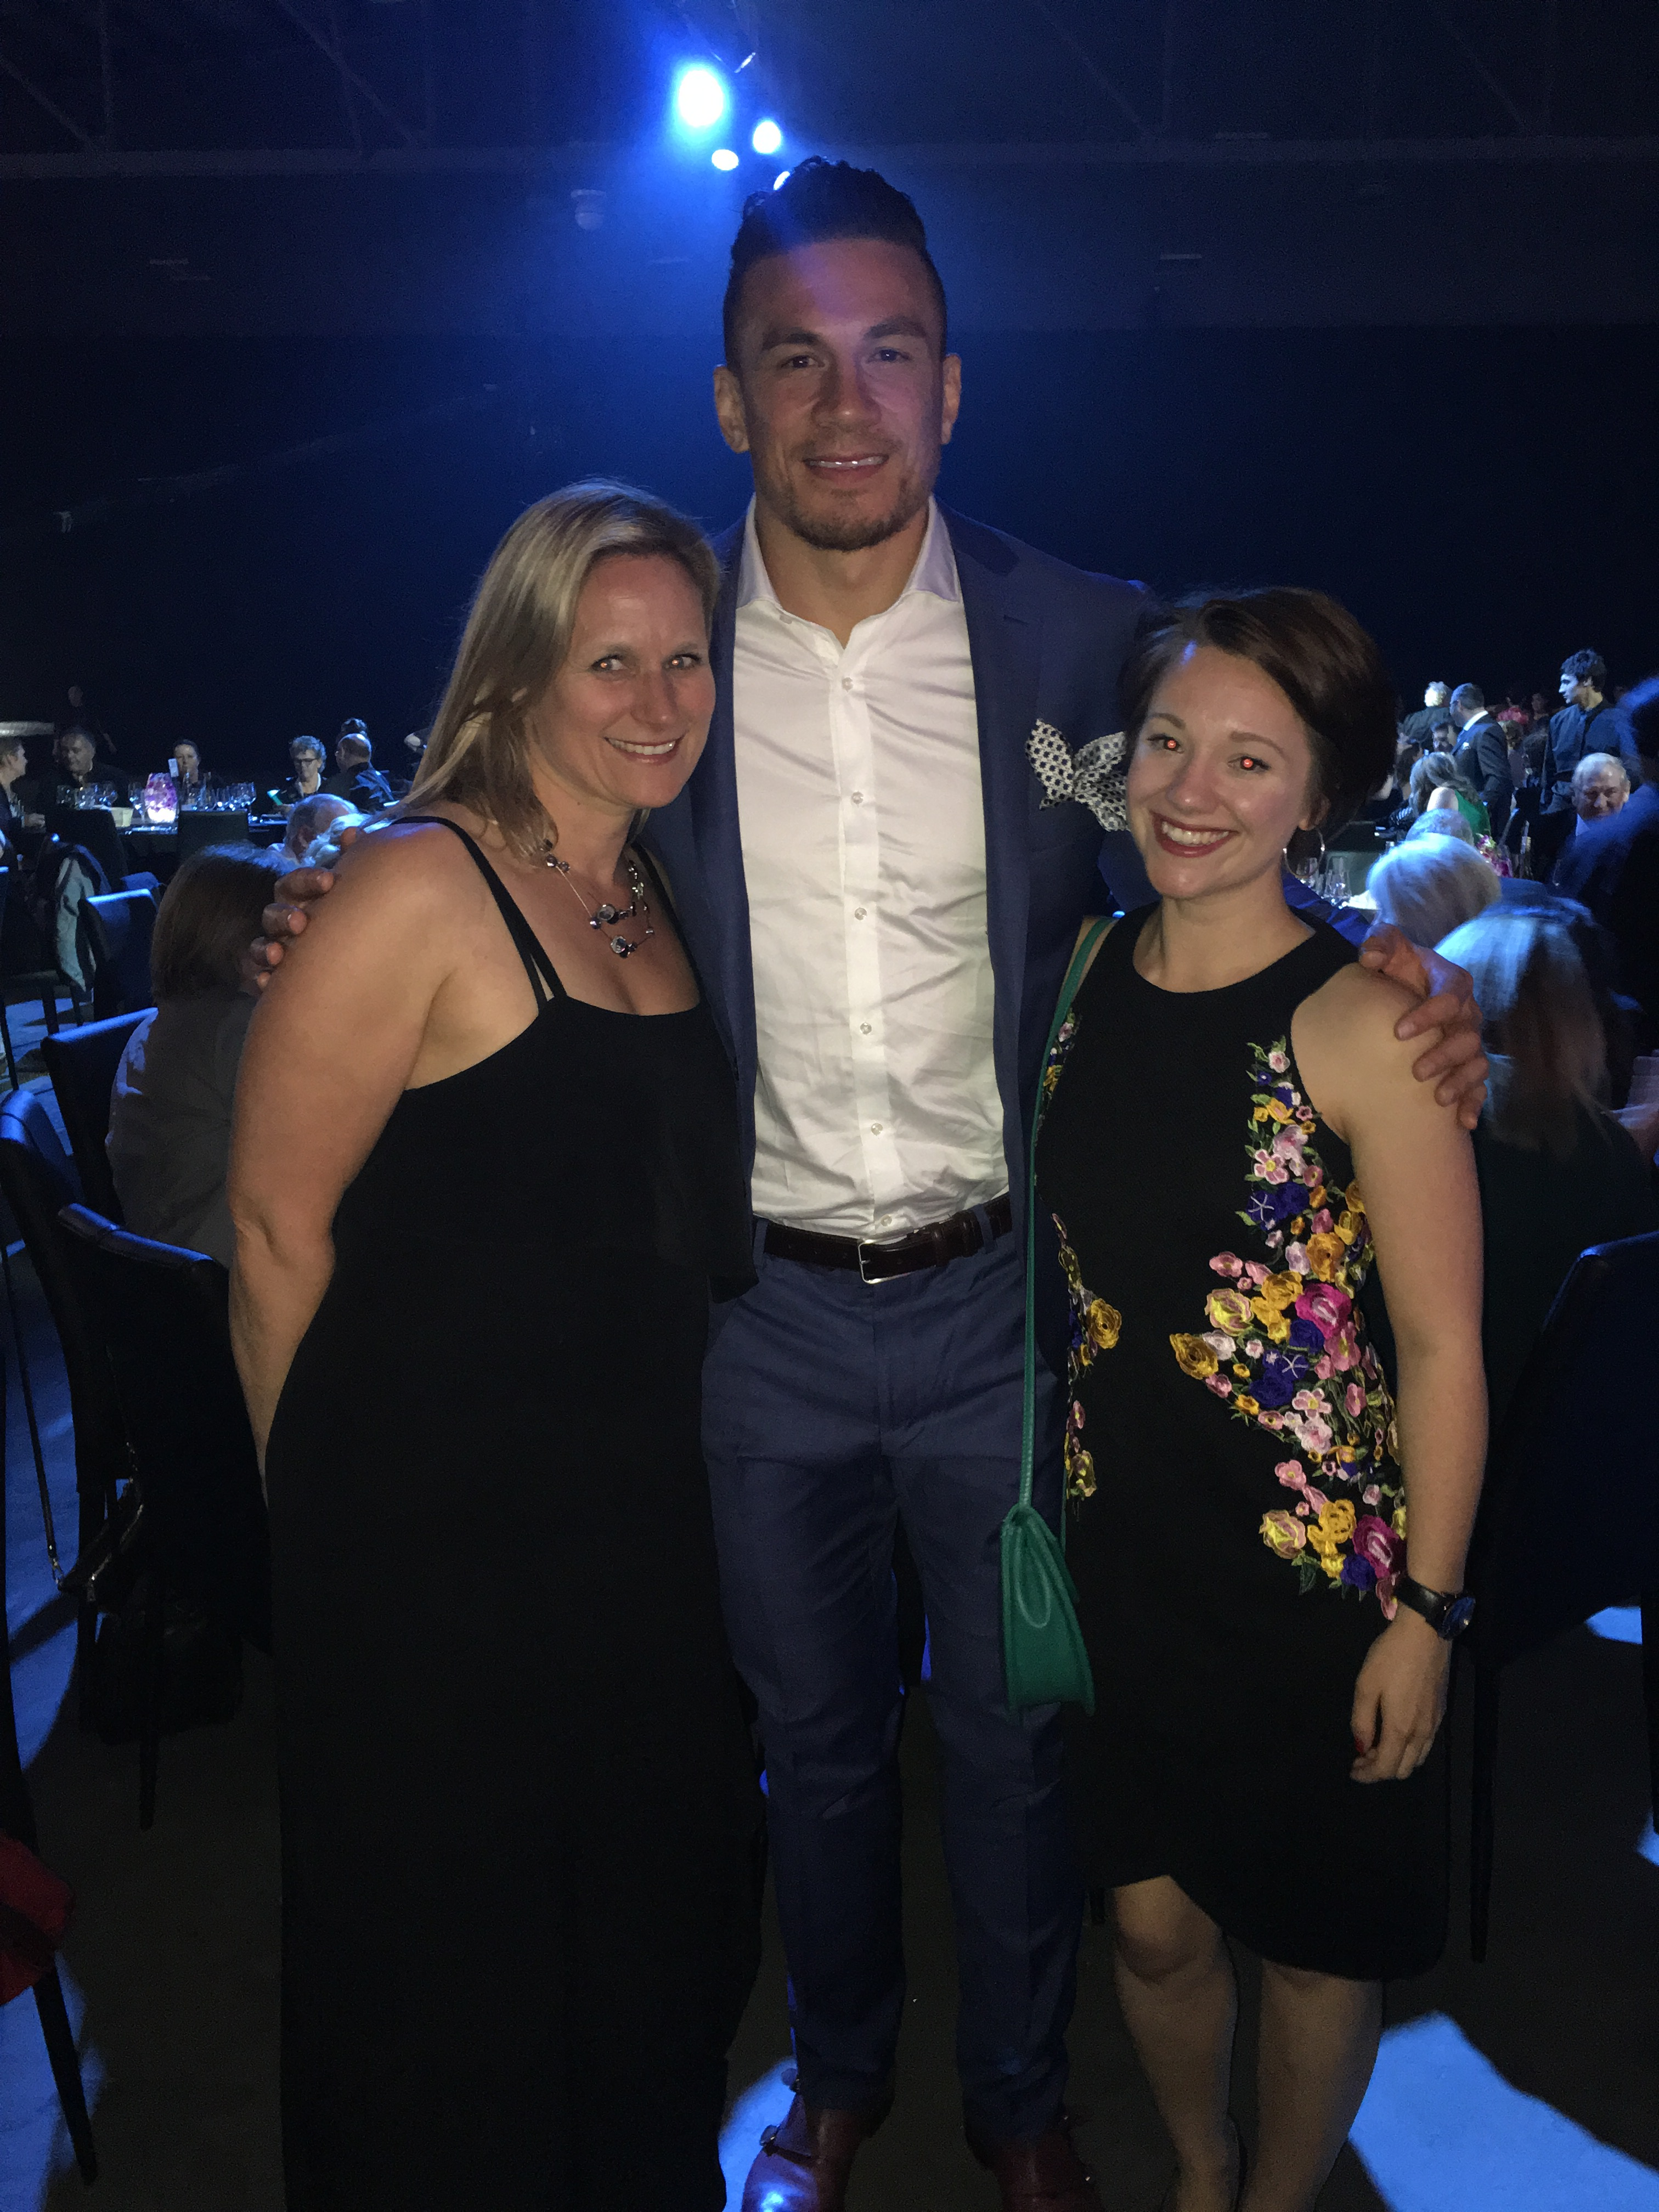
Met some famous people along the way

Slide 11
Strategy 2016-2026
Accessible copies available
Large print
Standard
Audio
New Zealand Sign Language (NZSL)
Braille

Slide 12

There is more work to be done
Development of an Outcomes Framework
  Accountability (teeth)
  Indicators and measures
  Complex
  Fairly new internationally
Disability Action Plan

Slide 13
www.odi.govt.nz
Any Questions?

